Slide 1
Lists
Chapter 8
Data Structures and Problem Solving with C++: Walls and Mirrors, Carrano and Henry, © 2013

Slide 2
Contents
Specifying the ADT List
Using the List Operations
An Interface Template for the ADT List
Data Structures and Problem Solving with C++: Walls and Mirrors, Carrano and Henry, © 2013

Slide 3
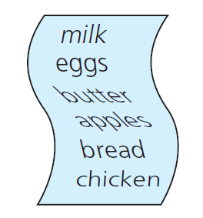
Specifying the ADT List
You reference list
items by their
position
FIGURE 8-1 A grocery list
Data Structures and Problem Solving with C++: Walls and Mirrors, Carrano and Henry, © 2013

Slide 4
ADT List Operations
Test whether a list is empty.
Get number of entries on a list.
Insert entry at given position on list.
Remove entry at given position from list.
Remove all entries from list.
Look at (get) entry at given position on list.
Replace (set) entry at given position on list.
Data Structures and Problem Solving with C++: Walls and Mirrors, Carrano and Henry, © 2013

Slide 5
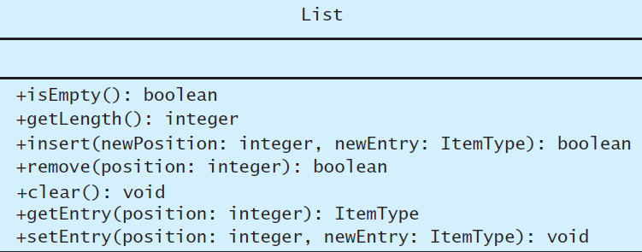
ADT List Operations
FIGURE 8-2 UML diagram for the ADT list
Data Structures and Problem Solving with C++: Walls and Mirrors, Carrano and Henry, © 2013

Slide 6
Abstract Data Type: LIST
Data : A finite number of objects
  Not necessarily distinct
  Having the same data type
  Ordered by their positions determined by client.
Data Structures and Problem Solving with C++: Walls and Mirrors, Carrano and Henry, © 2013

Slide 7
Abstract Data Type: LIST
Operations
  isEmpty()
  getLength()
  insert(newPosition, newEntry)
  remove(position)
  clear()
  getEntry(position)
  setEntry(position, newEntry)
Data Structures and Problem Solving with C++: Walls and Mirrors, Carrano and Henry, © 2013

Slide 8
Axioms for the ADT List
(new List()).isEmpty() = true
(new List()).getLength() = 0
aList.getLength()=(aList.insert(i, x)).getLength() - 1
aList.getLength()=(aList.remove(i)).getLength() + 1
(aList.insert(i, item)).isEmpty() = false
(new List()).remove(i) = false
(aList.insert(i, x)).remove(i) = aList
Data Structures and Problem Solving with C++: Walls and Mirrors, Carrano and Henry, © 2013

Slide 9
Axioms for the ADT List
(new List()).getEntry(i) = error
(aList.insert(i, x)).getEntry(i) = x
aList.getEntry(i) = (aList.insert(i, x)).getEntry(i + 1)
aList.getEntry(i + 1) = (aList.remove(i)).getEntry(i)
(new List()).setEntry(i, x) = error
(aList.setEntry(i, x)).getEntry(i) = x
Data Structures and Problem Solving with C++: Walls and Mirrors, Carrano and Henry, © 2013

Slide 10
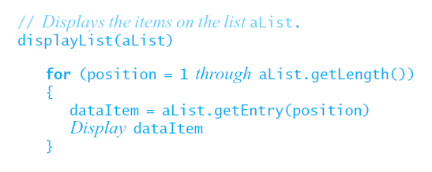
Using the List Operations
Displaying the items on a list independent of the implementation
Data Structures and Problem Solving with C++: Walls and Mirrors, Carrano and Henry, © 2013

Slide 11
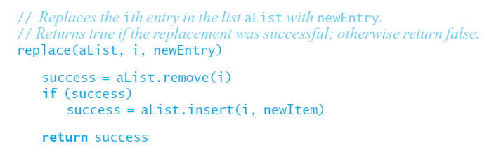
Using the List Operations
Replacing an item.
Data Structures and Problem Solving with C++: Walls and Mirrors, Carrano and Henry, © 2013

Slide 12
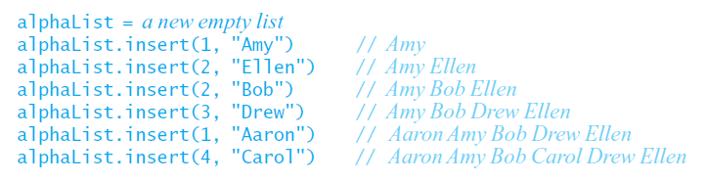
Using the List Operations
Pseudocode statements place names in an alphabetical list
View Interface Template for the ADT List,
Listing 8-1
.htm code listing files must be in the same folder as the .ppt files for these links to work
Data Structures and Problem Solving with C++: Walls and Mirrors, Carrano and Henry, © 2013

Slide 13
End
Chapter 8
Data Structures and Problem Solving with C++: Walls and Mirrors, Carrano and Henry, © 2013

